Slide 1
Understand Your Data--Before You Analyze It
How are my data distributed? Are your data fairly normal (bell-shaped) or skewed in one direction? A skewed distribution can affect some analyses, such as t-tests, especially if your sample is small.
How much does the data vary? Look to see how your data is spread. Is it spread evenly over high and low values? How about the confidence intervals? Are they wide? Is the standard deviation high? More variability means less certainty and less precision in your estimates.
Do I have outliers? Check out any extreme values in your data set. They can have a big impact on your results. If they’re mistakes, correct or remove them from your data before you perform an analysis.
Data Mining: Concepts and Techniques

Slide 2

What is Data?
Attributes
Collection of data objects and their attributes
An attribute is a property or characteristic of an object
  Examples: eye color of a person, temperature, etc.
  Attribute is also known as variable, field, characteristic, or feature
A collection of attributes describe an object
  Object is also known as record, point, case, sample, entity, or instance
Objects

Slide 3
Attribute Values
Attribute values are numbers or symbols assigned to an attribute
Distinction between attributes and attribute values
  Same attribute can be mapped to different attribute values
    Example: height can be measured in feet or meters
  Different attributes can be mapped to the same set of values
    Example: Attribute values for ID and age are integers
    But properties of attribute values can be different
      ID has no limit but age has a maximum and minimum value

Slide 4
Types of Attributes
There are different types of attributes
  Nominal
    Examples: ID numbers, eye color, zip codes
  Ordinal
    Examples: rankings (e.g., taste of potato chips on a scale from 1-10), grades, height in {tall, medium, short}
  Interval
    Examples: calendar dates, temperatures in Celsius or Fahrenheit.
  Ratio
    Examples: temperature in Kelvin, length, time, counts

Slide 5
Properties of Attribute Values
The type of an attribute depends on which of the following properties it possesses:
  Distinctness: = ≠
  Order: < >
  Addition: + -
  Multiplication: * /
  Nominal attribute: distinctness
  Ordinal attribute: distinctness & order
  Interval attribute: distinctness, order & addition
  Ratio attribute: all 4 properties

Slide 6
Attribute Type
Description
Examples
Operations
The values of a nominal attribute are just different names, i.e., nominal attributes provide only enough information to distinguish one object from another. (=, ≠)
zip codes, employee ID numbers, eye color, sex: {male, female}
mode, entropy, correlation, χ² test
Nominal
Ordinal
The values of an ordinal attribute provide enough information to order objects. (<, >)
hardness of minerals, {good, better, best},
grades, street numbers
median, percentiles, rank correlation,
Interval
For interval attributes, the differences between values are meaningful, i.e., a unit of measurement exists.
(+, - )
calendar dates, temperature in Celsius or Fahrenheit
mean, standard deviation, Pearson's correlation, t and F tests
Ratio
For ratio variables, both differences and ratios are meaningful. (*, /)
temperature in Kelvin, monetary quantities, counts, age, mass, length, electrical current
geometric mean, harmonic mean, percent variation

Slide 7
Data Preprocessing
Why preprocess the data?
Descriptive data summarization
Data cleaning
Data integration and transformation
Data reduction
Discretization and concept hierarchy generation
Summary
Data Mining: Concepts and Techniques

Slide 8
Why Data Preprocessing?
Data in the real world is dirty
  incomplete: lacking attribute values, lacking certain attributes of interest, or containing only aggregate data
    e.g., occupation=“ ”
  noisy: containing errors or outliers
    e.g., Salary=“-10”
  inconsistent: containing discrepancies in codes or names
    e.g., Age=“42” Birthday=“03/07/1997”
    e.g., Was rating “1,2,3”, now rating “A, B, C”
    e.g., discrepancy between duplicate records
Data Mining: Concepts and Techniques

Slide 9
Why Is Data Dirty?
Incomplete data may come from
  “Not applicable” data value when collected
  Different considerations between the time when the data was collected and when it is analyzed.
  Human/hardware/software problems
Noisy data (incorrect values) may come from
  Faulty data collection instruments
  Human or computer error at data entry
  Errors in data transmission
Inconsistent data may come from
  Different data sources
  Functional dependency violation (e.g., modify some linked data)
Duplicate records also need data cleaning
Data Mining: Concepts and Techniques

Slide 10
Why Is Data Preprocessing Important?
No quality data, no quality mining results!
  Quality decisions must be based on quality data
    e.g., duplicate or missing data may cause incorrect or even misleading statistics.
  Data warehouse needs consistent integration of quality data
Data extraction, cleaning, and transformation comprises the majority of the work of building a data warehouse
Data Mining: Concepts and Techniques

Slide 11
Major Tasks in Data Preprocessing
Data cleaning
  Fill in missing values, smooth noisy data, identify or remove outliers, and resolve inconsistencies
Data integration
  Integration of multiple databases, data cubes, or files
Data transformation
  Normalization and aggregation
Data reduction
  Obtains reduced representation in volume but produces the same or similar analytical results
Data discretization
  Part of data reduction but with particular importance, especially for numerical data
Data Mining: Concepts and Techniques

Slide 12

Forms of Data Preprocessing
Data Mining: Concepts and Techniques

Slide 13
Chapter 2: Data Preprocessing
Why preprocess the data?
Descriptive data summarization
Data cleaning
Data integration and transformation
Data reduction
Discretization and concept hierarchy generation
Summary
Data Mining: Concepts and Techniques

Slide 14
Mining Data Descriptive Characteristics
Motivation
  To better understand the data: central tendency, variation and spread
Data dispersion characteristics
  median, max, min, quantiles, outliers, variance, etc.
Numerical dimensions correspond to sorted intervals
  Data dispersion: analyzed with multiple granularities of precision
  Boxplot or quantile analysis on sorted intervals
Data Mining: Concepts and Techniques

Slide 15
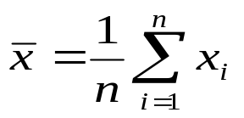

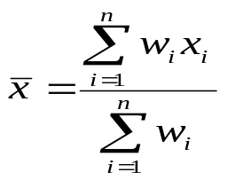
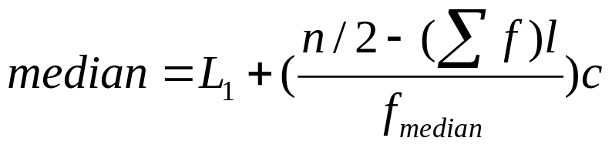
Measuring the Central Tendency
Mean (algebraic measure) (sample vs. population):
  Weighted arithmetic mean:
Median: A holistic measure
  Middle value if odd number of values, or average of the middle two values otherwise
  Estimated by interpolation (for grouped data):
Mode
  Value that occurs most frequently in the data
  Empirical formula:
Data Mining: Concepts and Techniques

Slide 16
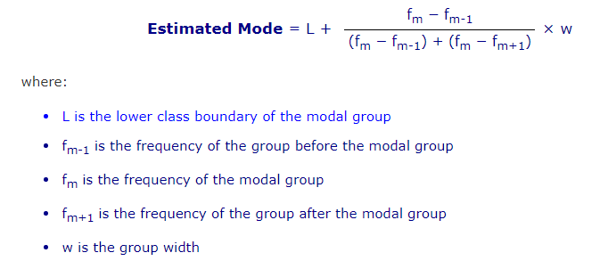
Mode for grouped data
Data Mining: Concepts and Techniques

Slide 17



Symmetric vs. Skewed Data
Median, mean and mode of symmetric, positively and negatively skewed data
Data Mining: Concepts and Techniques

Slide 18


Measuring the Dispersion of Data
Quartiles, outliers and boxplots
  Quartiles: Q₁ (25th percentile), Q₃ (75th percentile)
  Inter-quartile range: IQR = Q₃ – Q₁
  Five number summary: min, Q₁, M, Q₃, max
  Boxplot: ends of the box are the quartiles, median is marked, whiskers, and plot outlier individually
  Outlier: usually, a value higher/lower than 1.5 x IQR
Variance and standard deviation (sample: s, population: σ)
  Variance: (algebraic, scalable computation)
  Standard deviation s (or σ) is the square root of variance s² ⁽or σ²⁾
Data Mining: Concepts and Techniques

Slide 19

Boxplot Analysis
In 1977, John Tukey published an efficient method for displaying a five-number data summary. The graph is called a box plot (also known as a box and whisker plot) and summarizes the following statistical measures:
Five-number summary of a distribution:
  Minimum, Q1, M, Q3, Maximum
Boxplot
  Data is represented with a box
  The ends of the box are at the first and third quartiles, i.e., the height of the box is IQR
  The median is marked by a line within the box
  Whiskers: two lines outside the box extend to Minimum and Maximum
Data Mining: Concepts and Techniques

Slide 20
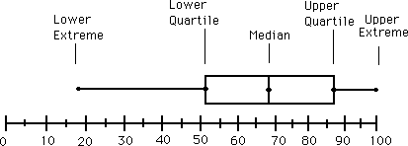
An example…
Note: the plot may be drawn either vertically or horizontally.

Slide 21
Interpreting a Box and Whisker Plot
The box itself contains the middle 50% of the data. The upper edge (hinge) of the box indicates the 75th percentile of the data set, and the lower hinge indicates the 25th percentile. The range of the middle two quartiles is known as the inter-quartile range.

Slide 22
Interpreting a Box and Whisker Plot (continued)
The line in the box indicates the median value of the data.
If the median line within the box is not equidistant from the hinges, then the data is skewed.

Slide 23
Interpreting a Box and Whisker Plot (continued)
The ends of the vertical lines or “whiskers” indicate the minimum and maximum values, unless outliers are present in which case the whiskers extend to a maximum of 1.5 times the inter-quartile range.
The points outside the ends of the “whiskers” are outliers or suspected outliers.

Slide 24
Advantages of Box and Whisker Plots
They provide a graphic display of a variable’s location and spread (or dispersion) at a glance.
They provide some indication of the data’s symmetry and skewness.
Unlike many other methods of data display, they show outliers.
They can easily be used to compare data sets.

Slide 25
Constructing a box-and-whisker plot:
The data: Math test scores 80, 75, 90, 95, 65, 65, 80, 85, 70, 100
Write the data in numerical order and find the first quartile, the median, the third quartile, the smallest value and the largest value.

Slide 26
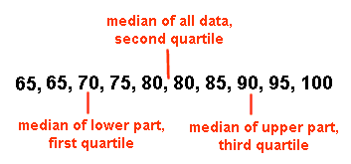
Constructing a box-and-whisker plot:
median = 80
first quartile = 70
third quartile = 90
smallest value = 65
largest value = 100

Slide 27
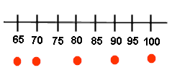
Constructing a box-and-whisker plot:
Place a circle beneath each of these values on a number line.

Slide 28
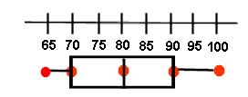
Constructing a box-and-whisker plot:
Draw a box with ends through the points for the first and third quartiles. Then draw a vertical line through the box at the median point. Now, draw the whiskers (or lines) from each end of the box to the smallest and largest values.

Slide 29
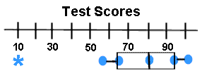
Constructing a box-and-whisker plot:
Special Case:
You may see a box-and-whisker plot, like the one below, which contains an asterisk.
Sometimes there is ONE piece of data that falls well outside the range of the other values. This single piece of data is called an outlier. If the outlier is included in the whisker, readers may think that there are grades dispersed throughout the whole range from the first quartile to the outlier.

Slide 30
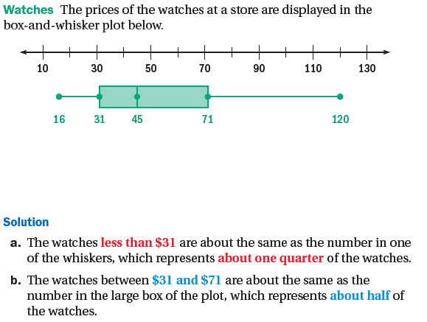
An Example
Data Mining: Concepts and Techniques

Slide 31
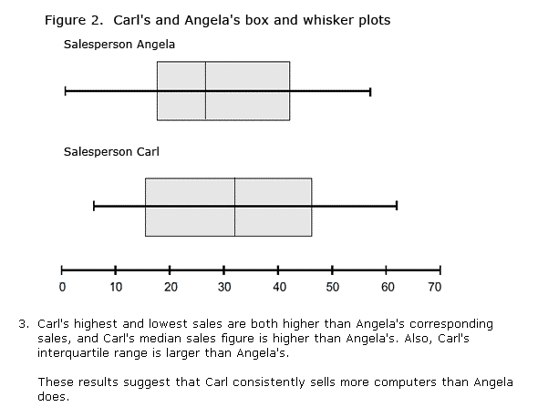
Comparison
Data Mining: Concepts and Techniques

Slide 32
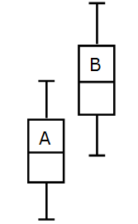
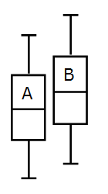
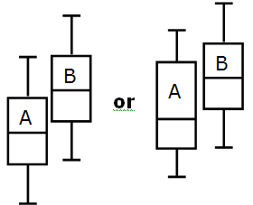

Slide 33
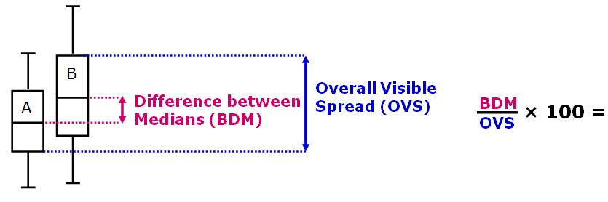
For a sample size of 30 if this percentage is over 33% there tends to be a difference between A and B
For a sample size of 100 if this percentage is over 20% there tends to be a difference between A and B
For a sample size of 1000 if this percentage is over 10% there tends to be a difference between A and B

Slide 34
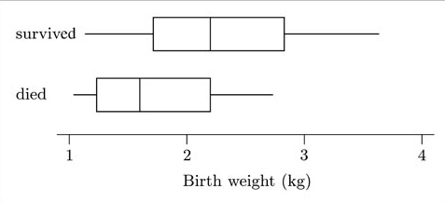

Slide 35

Comparison of location: the median birth weight of infants who survived is greater than that of those who died.
Comparison of dispersion: The interquartile ranges are reasonably similar (as shown by the lengths of the boxes), though the overall range of the data set is greater for the surviving infants (as shown by the distances between the ends of the two whiskers for each boxplot).
Comparison of skewness: Though both batches of data appear to be right-skew, and the batch for the infants who died is slightly more skewed than that for those who survived, the skewness is not particularly marked in either case.
Comparison of potential outliers: Neither data set shows any suspiciously far out values which might require a closer look.
General conclusions: Overall, the two batches of data look as if they were generally distributed in a similar way, but with one batch located to the right (larger location) of the other. You can see immediately that the median birth weight of infants who died is less than the lower quartile of the birth weights of infants who survived (that is, over three-quarters of the survivors were heavier than the median birth weight of those who died). So it looks as if we can safely say that survival is related to birth weight.

Slide 36
Mother educated for six years or less
14 13 4 14 10 2 13 5 0 0 13 3 9 2 10 11 13 5 14
Mother educated for seven years or more
0 4 0 2 3 3 0 4 7 1 9 4 3 2 3 2 16 6 0 13 6 6 5 9 10 5 4 3 3 5 2 3 5 15 5
Compare the two samples of data using the systematic approach just outlined in the text. What conclusions can you draw about an association between education and family size?

Slide 37
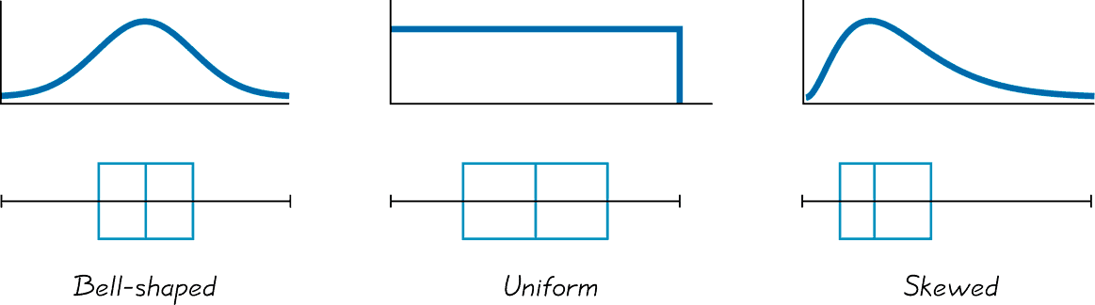
Comparison of Boxplots and histograms

Slide 38
Box and Whisker Plots
Box and Whisker Plots are a method used to analyze a given set of data.
Let’s use some pretend math scores as a sample data set:
77,81, 83, 85, 85, 86, 86, 87, 89, 90, 93, 93, 97, 100

Slide 39
70
75
80
85
90
95
100

Slide 40
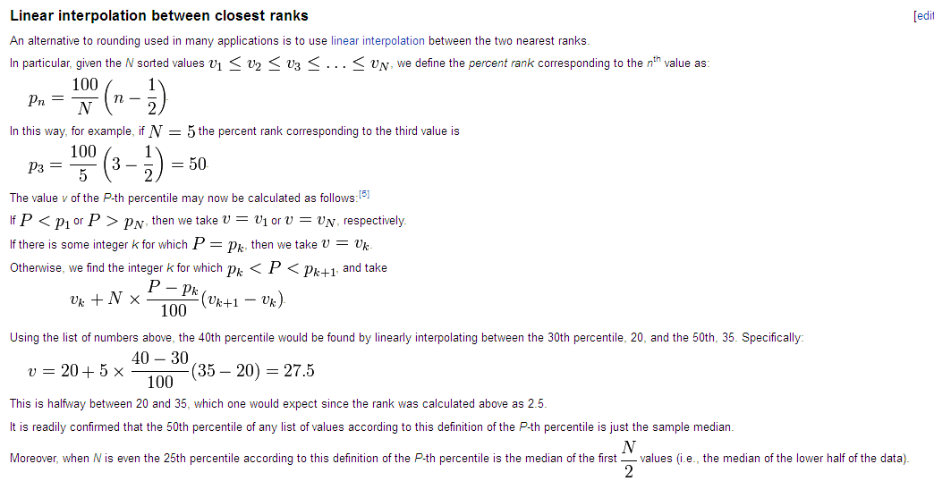
Data Mining: Concepts and Techniques

Slide 41
Consider the ordered list {15, 20, 35, 40, 50}, which contains five data values. What are the 5th, 30th, 40th and 95th percentiles of this list using the Linear Interpolation Between Closest Ranks method? First, we calculate the percent rank for each list value.
Data Mining: Concepts and Techniques

Slide 42
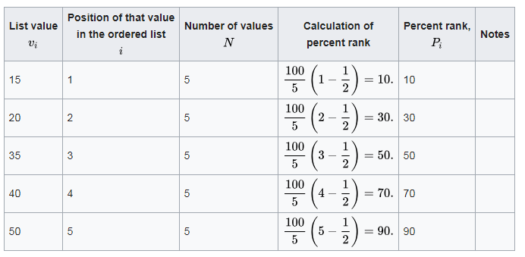
Data Mining: Concepts and Techniques

Slide 43
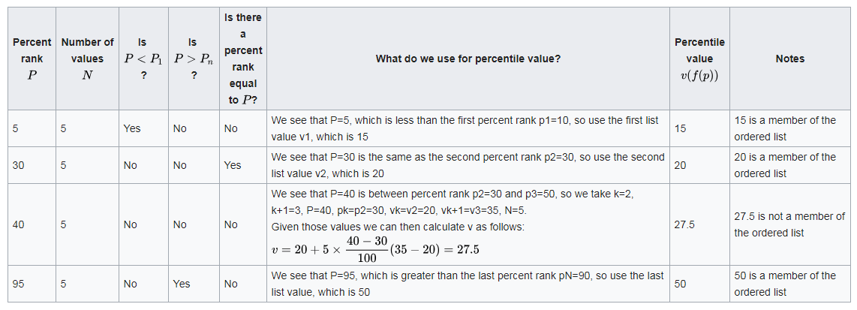
Data Mining: Concepts and Techniques

Slide 44
Data Preprocessing
Why preprocess the data?
Descriptive data summarization
Data cleaning
Data integration and transformation
Data reduction
Discretization and concept hierarchy generation
Summary
Data Mining: Concepts and Techniques

Slide 45
Data Cleaning
Importance
  “Data cleaning is one of the three biggest problems in data warehousing”—Ralph Kimball
  “Data cleaning is the number one problem in data warehousing”—DCI survey
Data cleaning tasks
  Fill in missing values
  Identify outliers and smooth out noisy data
  Correct inconsistent data
  Resolve redundancy caused by data integration
Data Mining: Concepts and Techniques

Slide 46
Missing Data
Data is not always available
  E.g., many tuples have no recorded value for several attributes, such as customer income in sales data
Missing data may be due to
  equipment malfunction
  inconsistent with other recorded data and thus deleted
  data not entered due to misunderstanding
  certain data may not be considered important at the time of entry
  not register history or changes of the data
Missing data may need to be inferred.
Data Mining: Concepts and Techniques

Slide 47
How to Handle Missing Data?
Ignore the tuple: usually done when class label is missing (assuming the tasks in classification—not effective when the percentage of missing values per attribute varies considerably.
Fill in the missing value manually: tedious + infeasible?
Fill in it automatically with
  a global constant : e.g., “unknown”, a new class?!
  the attribute mean
  the attribute mean for all samples belonging to the same class: smarter
  the most probable value: inference-based such as Bayesian formula or decision tree
Data Mining: Concepts and Techniques

Slide 48
Noisy Data
Noise: random error or variance in a measured variable
Incorrect attribute values may due to
  faulty data collection instruments
  data entry problems
  data transmission problems
  technology limitation
  inconsistency in naming convention
Other data problems which requires data cleaning
  duplicate records
  incomplete data
  inconsistent data
Data Mining: Concepts and Techniques

Slide 49
How to Handle Noisy Data?
Binning
  first sort data and partition into (equal-frequency) bins
  then one can smooth by bin means, smooth by bin median, smooth by bin boundaries, etc.
Regression
  smooth by fitting the data into regression functions
Clustering
  detect and remove outliers
Combined computer and human inspection
  detect suspicious values and check by human (e.g., deal with possible outliers)
Data Mining: Concepts and Techniques

Slide 50
Simple Discretization Methods: Binning
Equal-width (distance) partitioning
  Divides the range into N intervals of equal size: uniform grid
  if A and B are the lowest and highest values of the attribute, the width of intervals will be: W = (B –A)/N.
  The most straightforward, but outliers may dominate presentation
  Skewed data is not handled well
Equal-depth (frequency) partitioning
  Divides the range into N intervals, each containing approximately same number of samples
  Good data scaling
  Managing categorical attributes can be tricky
Data Mining: Concepts and Techniques

Slide 51
Binning Methods for Data Smoothing
Sorted data for price (in dollars): 4, 8, 9, 15, 21, 21, 24, 25, 26, 28, 29, 34
* Partition into equal-frequency (equi-depth) bins:
- Bin 1: 4, 8, 9, 15
- Bin 2: 21, 21, 24, 25
- Bin 3: 26, 28, 29, 34
* Smoothing by bin means:
- Bin 1: 9, 9, 9, 9
- Bin 2: 23, 23, 23, 23
- Bin 3: 29, 29, 29, 29
* Smoothing by bin boundaries:
- Bin 1: 4, 4, 4, 15
- Bin 2: 21, 21, 25, 25
- Bin 3: 26, 26, 26, 34
Data Mining: Concepts and Techniques

Slide 52
Regression
y
Y1
Y1’
y = x + 1
X1
x
Data Mining: Concepts and Techniques

Slide 53
Cluster Analysis
Data Mining: Concepts and Techniques

Slide 54
Chapter 2: Data Preprocessing
Why preprocess the data?
Data cleaning
Data integration and transformation
Data reduction
Discretization and concept hierarchy generation
Summary
Data Mining: Concepts and Techniques

Slide 55
Data Integration
Data integration:
  Combines data from multiple sources into a coherent store
Schema integration: e.g., A.cust-id ≡ B.cust-#
  Integrate metadata from different sources
Entity identification problem:
  Identify real world entities from multiple data sources, e.g., Bill Clinton = William Clinton
Detecting and resolving data value conflicts
  For the same real world entity, attribute values from different sources are different
  Possible reasons: different representations, different scales, e.g., metric vs. British units
Data Mining: Concepts and Techniques

Slide 56
Handling Redundancy in Data Integration
Redundant data occur often when integration of multiple databases
  Object identification: The same attribute or object may have different names in different databases
  Derivable data: One attribute may be a “derived” attribute in another table, e.g., annual revenue
Redundant attributes may be able to be detected by correlation analysis
Careful integration of the data from multiple sources may help reduce/avoid redundancies and inconsistencies and improve mining speed and quality
Data Mining: Concepts and Techniques

Slide 57
Data Transformation
Smoothing: remove noise from data
Aggregation: summarization, data cube construction
Generalization: concept hierarchy climbing
Normalization: scaled to fall within a small, specified range
  min-max normalization
  z-score normalization
Attribute/feature construction
  New attributes constructed from the given ones
Data Mining: Concepts and Techniques

Slide 58



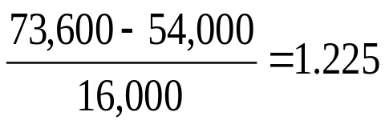
Data Transformation: Normalization
Min-max normalization: to [new_min_{A}, new_max_{A}]
  Ex. Let income range $12,000 to $98,000 normalized to [0.0, 1.0]. Then $73,000 is mapped to
Z-score normalization (μ: mean, σ: standard deviation):
  Ex. Let μ = 54,000, σ = 16,000. Then
Data Mining: Concepts and Techniques

Slide 59
Chapter 2: Data Preprocessing
Why preprocess the data?
Data cleaning
Data integration and transformation
Data reduction
Discretization and concept hierarchy generation
Summary
Data Mining: Concepts and Techniques

Slide 60
Data Reduction Strategies
Why data reduction?
  A database/data warehouse may store terabytes of data
  Complex data analysis/mining may take a very long time to run on the complete data set
Data reduction
  Obtain a reduced representation of the data set that is much smaller in volume but yet produce the same (or almost the same) analytical results
Data reduction strategies
  Dimensionality reduction — e.g., remove unimportant attributes
  Data Compression
  Numerosity reduction — e.g., fit data into models
  Discretization and concept hierarchy generation
  Sampling
Data Mining: Concepts and Techniques

Slide 61
Attribute Subset Selection
Feature selection (i.e., attribute subset selection):
  Select a minimum set of features such that the probability distribution of different classes given the values for those features is as close as possible to the original distribution given the values of all features
  reduce # of patterns in the patterns, easier to understand
Data Mining: Concepts and Techniques

Slide 62
Feature Subset Selection
Techniques:
  Brute-force approch:
    Try all possible feature subsets as input to data mining algorithm
  Embedded approaches:
    Feature selection occurs naturally as part of the data mining algorithm
  Filter approaches:
    Features are selected before data mining algorithm is run
  Wrapper approaches:
    Use the data mining algorithm as a black box to find best subset of attributes

Slide 63
Example of Decision Tree Induction
Initial attribute set:
{A1, A2, A3, A4, A5, A6}
A4 ?
A1?
A6?
Class 1
Class 2
Class 1
Class 2
>
Reduced attribute set: {A1, A4, A6}
Data Mining: Concepts and Techniques

Slide 64
Sampling
Sampling is the main technique employed for data selection.
  It is often used for both the preliminary investigation of the data and the final data analysis.
Statisticians sample because obtaining the entire set of data of interest is too expensive or time consuming.
Sampling is used in data mining because processing the entire set of data of interest is too expensive or time consuming.

Slide 65
Sampling …
The key principle for effective sampling is the following:
  using a sample will work almost as well as using the entire data sets, if the sample is representative
  A sample is representative if it has approximately the same property (of interest) as the original set of data

Slide 66
Types of Sampling
Simple Random Sampling
  There is an equal probability of selecting any particular item
Sampling without replacement
  As each item is selected, it is removed from the population
Sampling with replacement
  Objects are not removed from the population as they are selected for the sample.
    In sampling with replacement, the same object can be picked up more than once
Stratified sampling
  Split the data into several partitions; then draw random samples from each partition

Slide 67
Summary
Data preparation or preprocessing is a big issue for both data warehousing and data mining
Descriptive data summarization is need for quality data preprocessing
Data preparation includes
  Data cleaning and data integration
  Data reduction and feature selection
  Discretization
A lot a methods have been developed but data preprocessing is still an active area of research
Data Mining: Concepts and Techniques

Slide 68
References
D. P. Ballou and G. K. Tayi. Enhancing data quality in data warehouse environments. Communications of ACM, 42:73-78, 1999
T. Dasu and T. Johnson. Exploratory Data Mining and Data Cleaning. John Wiley & Sons, 2003
T. Dasu, T. Johnson, S. Muthukrishnan, V. Shkapenyuk. Mining Database Structure; Or, How to Build a Data Quality Browser. SIGMOD’02.
H.V. Jagadish et al., Special Issue on Data Reduction Techniques. Bulletin of the Technical Committee on Data Engineering, 20(4), December 1997
D. Pyle. Data Preparation for Data Mining. Morgan Kaufmann, 1999
E. Rahm and H. H. Do. Data Cleaning: Problems and Current Approaches. IEEE Bulletin of the Technical Committee on Data Engineering. Vol.23, No.4
V. Raman and J. Hellerstein. Potters Wheel: An Interactive Framework for Data Cleaning and Transformation, VLDB’2001
T. Redman. Data Quality: Management and Technology. Bantam Books, 1992
Y. Wand and R. Wang. Anchoring data quality dimensions ontological foundations. Communications of ACM, 39:86-95, 1996
R. Wang, V. Storey, and C. Firth. A framework for analysis of data quality research. IEEE Trans. Knowledge and Data Engineering, 7:623-640, 1995
Data Mining: Concepts and Techniques

